Slide 1
Notes:
Picture from: https://www.sparkfun.com/products/9190

Slide 2
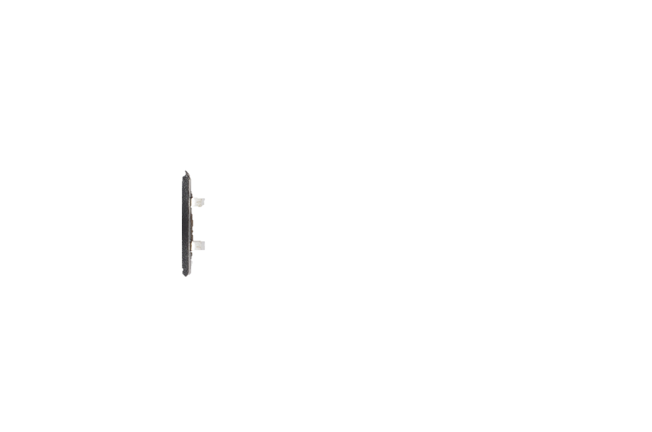
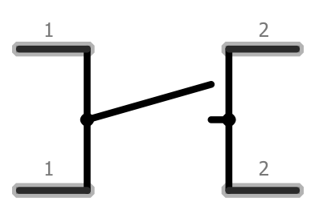
Notes:
Picture from: https://www.sparkfun.com/products/9190

Slide 3

Notes:
Picture from: https://www.sparkfun.com/products/9190

Slide 4
Unpressed
PRESSED
Connected
Connected
All 4 legs become connected

Slide 5
Unpressed
Unpressed
PRESSED
Default state
Connected
Connected
All 4 legs become connected
Connected

Slide 6
Unpressed
PRESSED
Default state
Connected
Connected
All 4 legs become connected
All 4 legs become connected
Connected

Slide 7
Notes:
Picture from: https://www.sparkfun.com/products/9190

Slide 8
Notes:
Picture from: https://www.sparkfun.com/products/9190

Slide 9
Notes:
Picture from: https://www.sparkfun.com/products/9190

Slide 10
Connected
Connected
Connected
Connected
Notes:
Picture from: https://www.sparkfun.com/products/9190

Slide 11
Connected
Connected
Connected
Connected
Notes:
Picture from: https://www.sparkfun.com/products/9190

Slide 12
Connected
Connected
Connected
Connected
Button pressed!
Notes:
Picture from: https://www.sparkfun.com/products/9190

Slide 13
Connected
Connected
Connected
Connected
Button pressed!
Notes:
Picture from: https://www.sparkfun.com/products/9190

Slide 14
Connected
Connected
Button pressed!
Notes:
Picture from: https://www.sparkfun.com/products/9190

Slide 15
Button pressed!
Notes:
Picture from: https://www.sparkfun.com/products/9190

